Slide 1
Case Study The Pearlsburg Rescue Squad

Slide 2
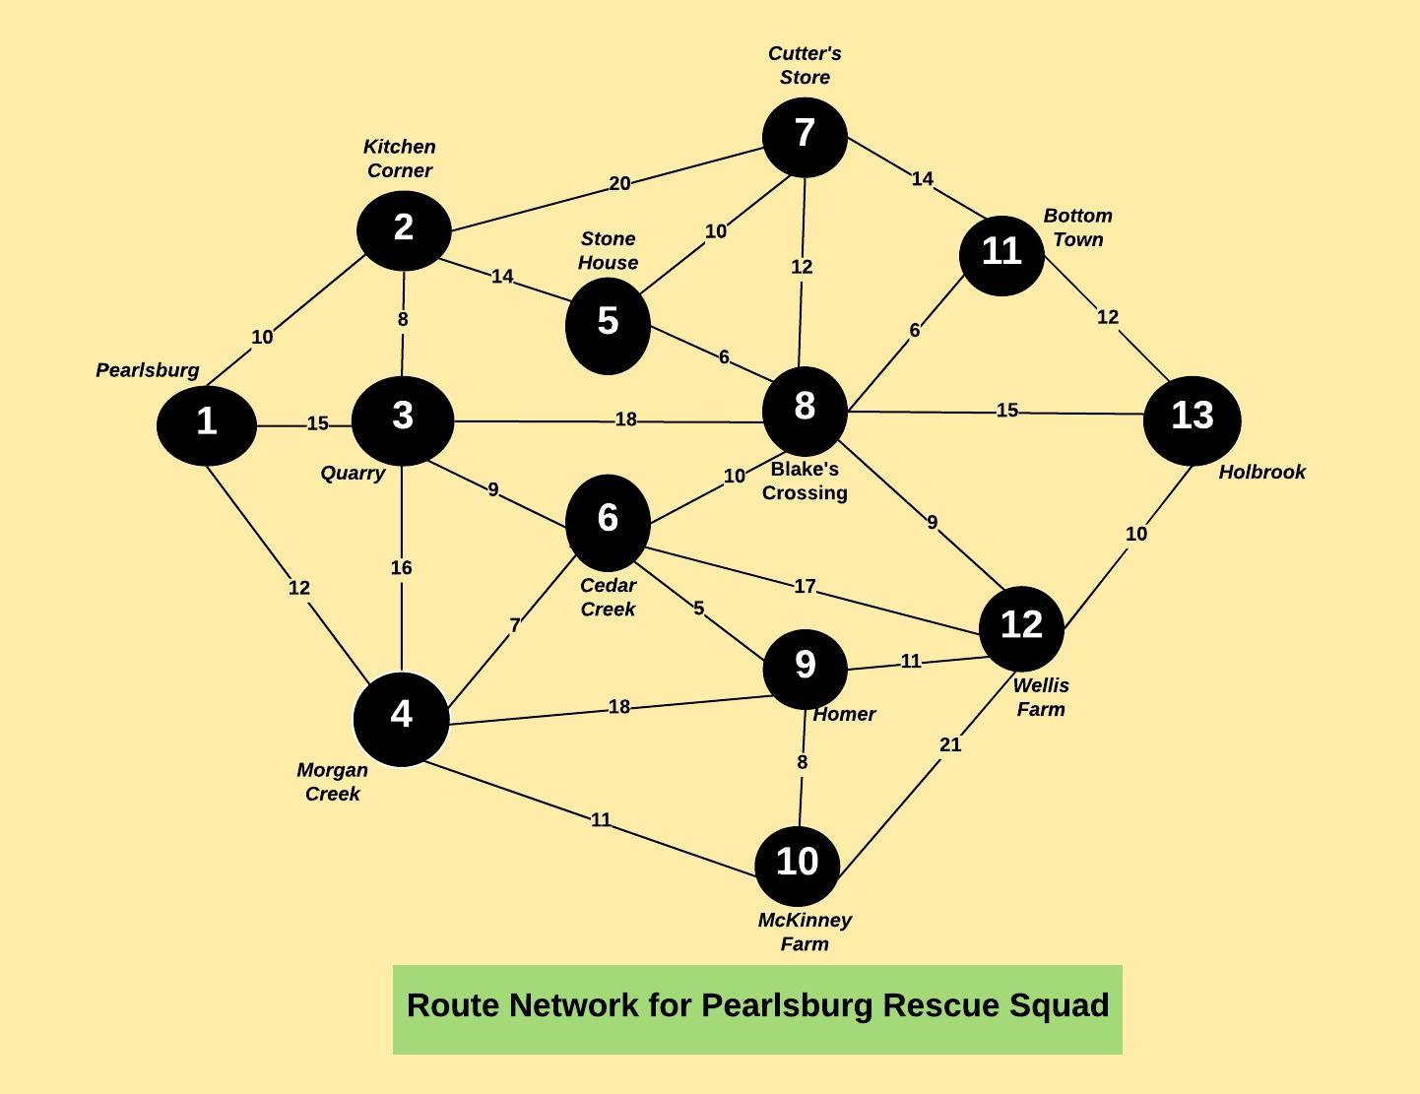
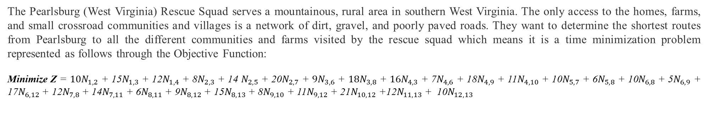
PROBLEM DEFINITION
The Pearlsburg (West Virginia) Rescue Squad serves a mountainous, rural area in southern West Virginia. The only access to the homes, farms, and small crossroad communities and villages is a network of dirt, gravel, and poorly paved roads. They want to determine the shortest routes from Pearlsburg to all the different communities and farms visited by the rescue squad which means it is a time minimization problem represented as follows through the Objective Function:
Minimize Z = ${10N}_{1,2}$ + 15$N_{1,3}$ + 12$N_{1,4}$ + 8$N_{2,3}$ + 14 $N_{2,5}$ + 20$N_{2,7}$ + ${9N}_{3,6}$ + ${18N}_{3,8}$ + ${16N}_{4,3}$ + 7$N_{4,6}$ + 18$N_{4,9}$ + 11$N_{4,10}$ + 10$N_{5,7}$ + 6$N_{5,8}$ + 10$N_{6,8}$+ 5$N_{6,9}$ + 17$N_{6,12}$ + 12$N_{7,8}$ + 14$N_{7,11}$ + 6$N_{8,11}$ + 9$N_{8,12}$ + 15$N_{8,13}$ + 8$N_{9,10}$ + 11$N_{9,12}$ + 21$N_{10,12}$ +12$N_{11,13}$ + 10$N_{12,13}$
The diagram shows the time taken to travel between different communities by the Pearlsburg Rescue Squad

Slide 3
CONSTRAINTS FACED BY THE RESCUE SQUAD
Let Node 1 = Pearlsburg, Node 2 = Kitchen Corner, Node 3 = Quarry, Node 4 = Morgan Creek, Node 5 = Stone House, Node 6 = Cedar Creek, Node 7 = Cutter's Store, Node 8 = Blake's Crossing, Node 9 = Homer, Node 10 = McKinney Farm, Node 11= Bottom Town, Node 12 = Wellis Farm, Node 13 = Holbrook
Node | Network Flow | Description
1 | 1 | All possible outflows from starting Node 1 (Pearlsburg)
2 | 0 | Net flow through Node 2 (Kitchen Corner)
3 | 0 | Net flow through Node 3 (Quarry)
4 | 0 | Net flow through Node 4 (Morgan Creek)
5 | 0 | Net flow through Node 5 (Stone House)
6 | 0 | Net flow through Node 6 (Cedar Creek)
7 | 0 | Net flow through Node 7 (Cutter's Store)
8 | 0 | Net flow through Node 8 (Blake's Crossing)
9 | 0 | Net flow through Node 9 (Homer)
10 | 0 | Net flow through Node 10 (McKinney Farm)
11 | 0 | Net flow through Node 11 (Bottom Town)
12 | 0 | Net flow through Node 12 (Wellis Farm)
13 | 1 | All possible inflows to terminal Node 13 (Holbrook)
Must depart or return from Pearlsburg
Flows be flows from Flows into each node must equal flows from each node ( Net Flows = 0)each node
(Network Flow =0)
Must connect to Holbrook

Slide 4

SOLUTION SYNOPSIS: Shortest Routes to different locations
Pearlsburg
10 min
23 min
Kitchen Corner
Pearlsburg
McKinney Farm
Via Morgan Creek
Pearlsburg
24 min
15 min
Pearlsburg
Quarry
Homer
Via Morgan Creek & Cedar Creek
Pearlsburg
Morgan Creek
29 min
12 min
Pearlsburg
Blake’s Crossing
Via Morgan Creek & Cedar Creek
Pearlsburg
24 min
Stone House
Pearlsburg
35 min
Bottom Town
Via Kitchen Corner
Via Morgan Creek & Cedar Creek & Blake’s Crossing
Pearlsburg
19 min
35 min
Cedar Creek
Pearlsburg
Wellis Farm
Via Morgan Creek
Via Morgan Creek & Cedar Creek & Homer
30 min
Pearlsburg
44 min
Pearlsburg
Cutter’s Store
Holbrook
Via Morgan Creek & Cedar Creek & Blake’s Crossing
Via Kitchen Corner

Slide 5
RECOMMENDATIONS
Common Route: From the solution synopsis, we can see that the shortest rote to most destinations requires going via Morgan Creek and Cedar Creek. So, to reduce travel time Pearlsburg Rescue Squad should consider taking Morgan Creek & Cedar Creek on their way as per the route map to reach various communities in shortest time.
Squad Station: Since Morgan Creek & Cedar Creek are common routes taken to reach further locations like Homer, Blake’s Crossing, Bottom Town, Wellis Farm and Holbrook, so the rescue squad should consider having a team stationed at Morgan Creek & Cedar Creek to save additional 12 to 20 minutes approximately.
Optimal Time: The Rescue Squad can reach Holbrook (furthest community) from Pearlsburg in 44 minutes which is the minimum time if it follows this route:
Pearlsburg Morgan Creek Cedar Creek Blake’s Crossing Holbrook
If there is a team stationed at Morgan Creek, then travel time to reach Holbrook will be 32 minutes which means they are saving additional 12 minutes.
If there is a team stationed at Cedar Creek, then the rescue squad can reach Holbrook in 25 minutes and hence, saving 19 minutes.
12 min
7 min
10 min
15 min

